Slide 1
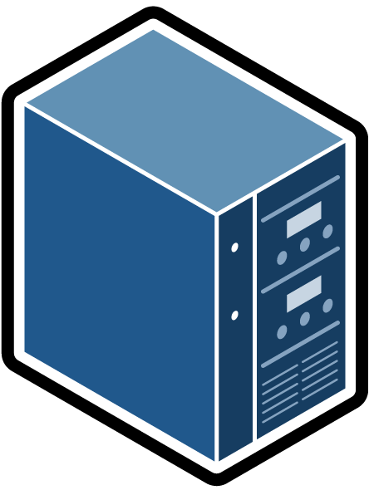
-j JSON_FILE, --json-file JSON_FILE
File that holds the current version of your Control-M
job definition file
-dd DEPLOY_DESCRIPTOR, --deploy-descriptor DEPLOY_DESCRIPTOR
File that holds the deploy-descriptor definition file
Print filtered and if specified transformed connection profile to console
-c CONFIG_FILE, --config-file CONFIG_FILE
JSON Config file with list of allowed agents
4
-m {filter,deploy}, --mode {filter,deploy}
Specifies to run this script in filter only mode or
deploy mode. Filter mode will only print the filtered (and
transformed) content.
Print deployment confirmation and the filtered and if specified transformed connection profile to console
Skip this step if no deploy descriptor is specified
Skip this step if no
config file is specified
*.json jobs-as-code file
Filter mode
1
Transform input file using the specified deploy descriptor file
2
Filter out any other object like folder and jobs definitions
3
Filter out any connection profiles with a Target Agent that is not specified in the configuration file
Deploy mode
REST API
/deploy/transform
REST API
/deploy/transform
Write filtered and if specified transformed connection profile to temp file <session token>.json
Deploy filtered and if specified transformed connection profile to provided end-point
Control-M EM AAPI
5
Control-M EM AAPI
-e ENDPOINT, --endpoint ENDPOINT
Control-M Automation API end-point for connecting with Control-M in deploy mode
-u USER, --user USER
Control-M user name for connecting with Control-M in deploy mode
-p PASSWORD, --password PASSWORD
Control-M password for connecting with Control-M in deploy mode

